Slide 1
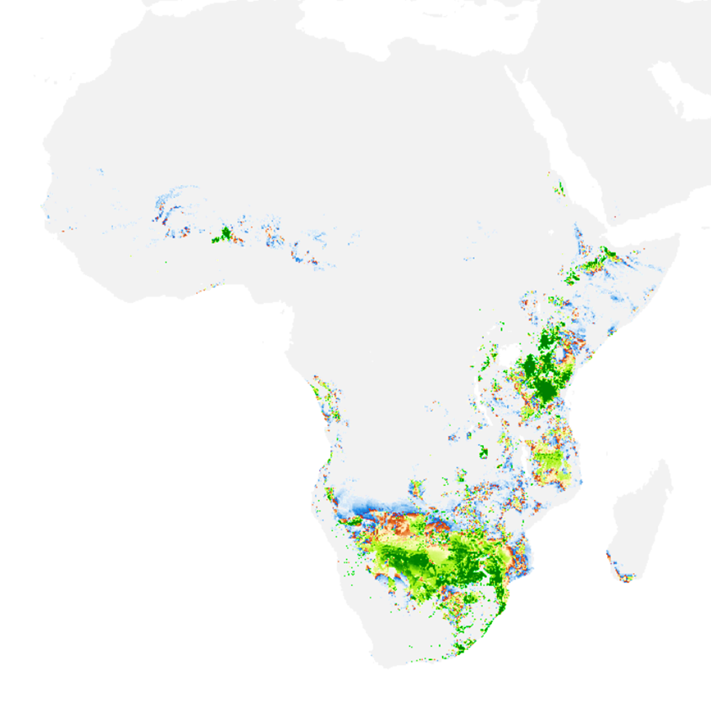
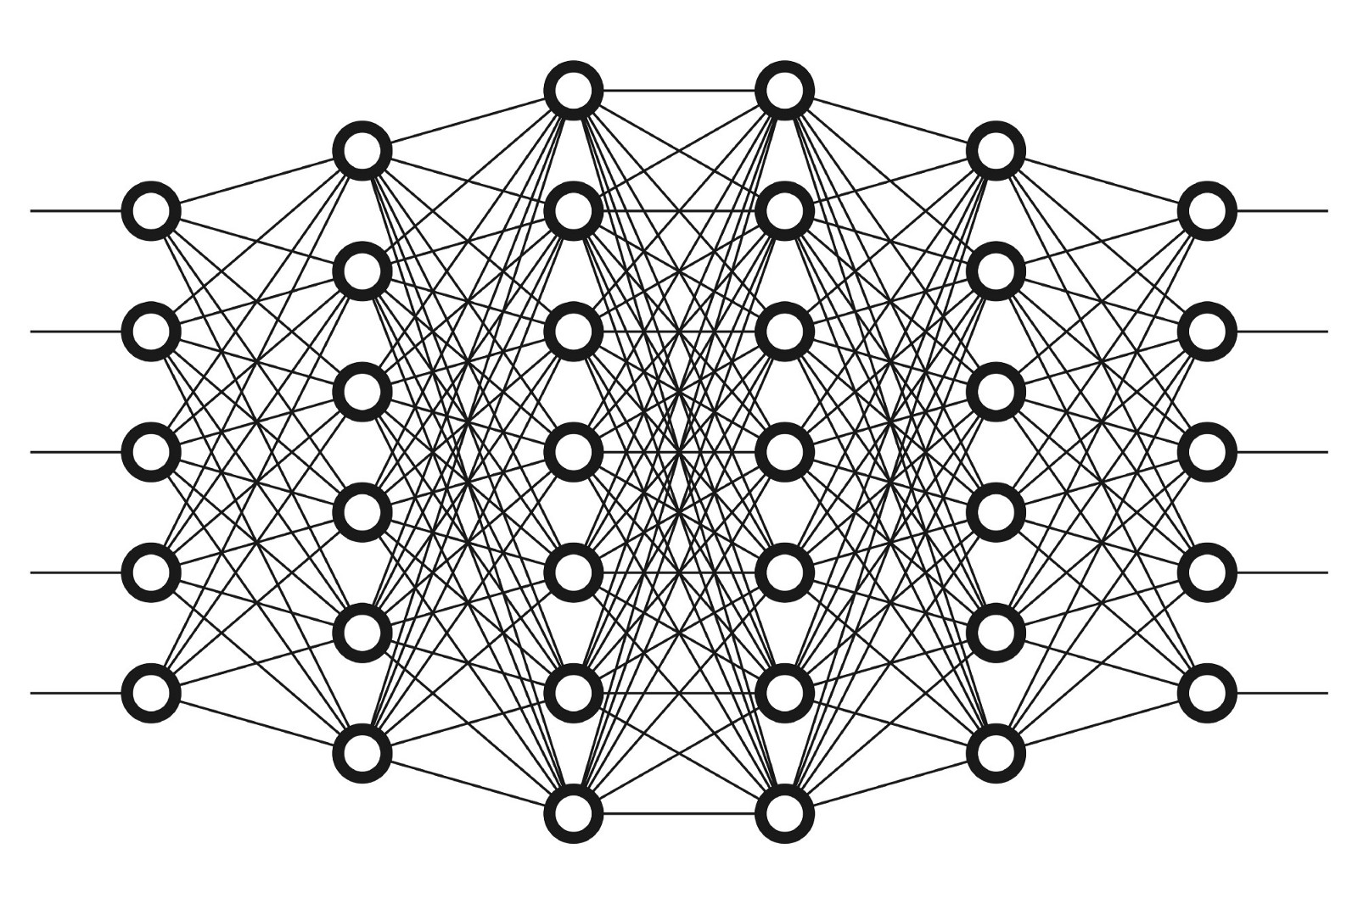
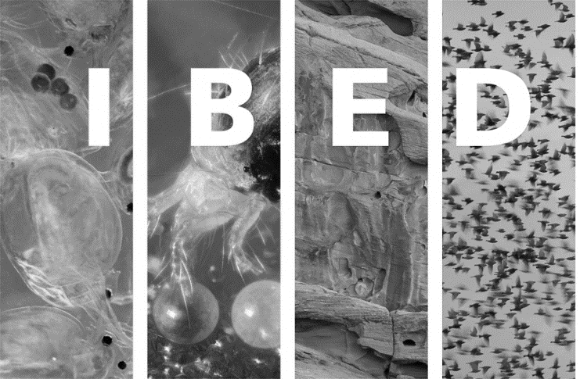
Deep Learning
Species Distribution Modelling
© Piotr Usewicz (2019)
Mark Rademaker
PhD @ Netherlands Institute for Sea Research (NIOZ)
Guest researcher IBED-UVA
Former Intern DL-SDM at Naturalis Biodiversity Centre

Slide 2
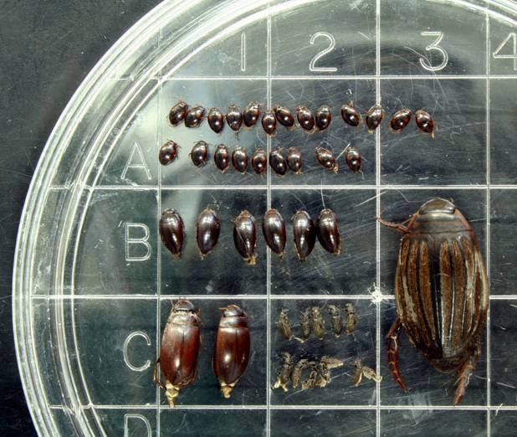
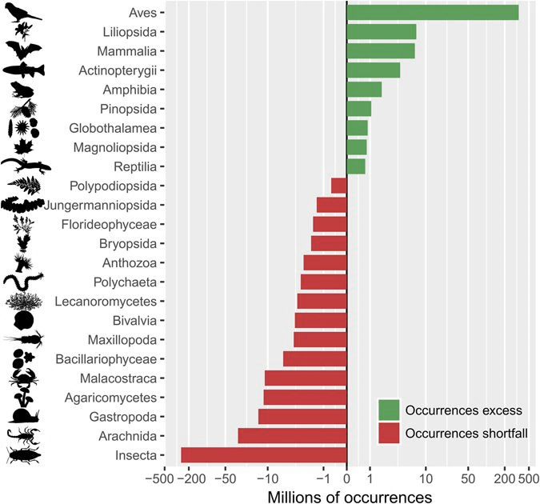
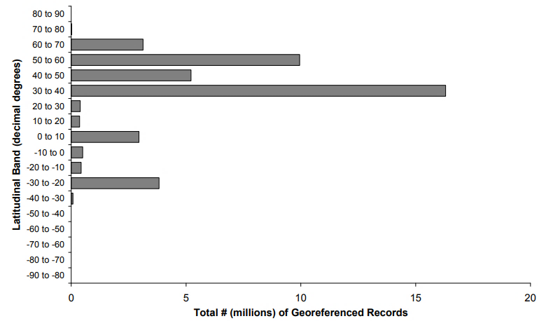
Background
Limited understanding where species occur and what makes areas suitable
Sampling difficulty and biases
Distribution of abundances¹
Taxonomic bias²
Geographic bias ³
Notes:
.

Slide 3
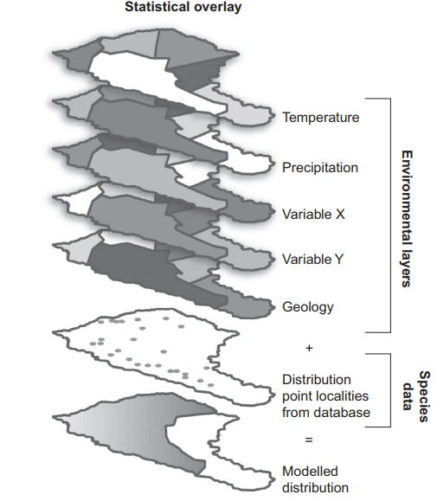
Species distribution models
Developed to address scarcity of data⁴
Relate patterns in occurrences to selection of environmental predictors
To predict probability of presence outside sampled areas⁵
This sounds like something deep learning could be really good at!

Slide 4
Deep Learning
Strong increase in use of DL in past two decades
Position within the AI-verse (adapted from MIT, 2019)
Artificial intelligence
Any technique that enables computers to mimic human behavior
Machine learning
Ability to learn without being explicitly programmed
Deep Learning
Extract patterns from data using neural networks

Slide 5
Deep Learning surprisingly accessible?

Slide 6
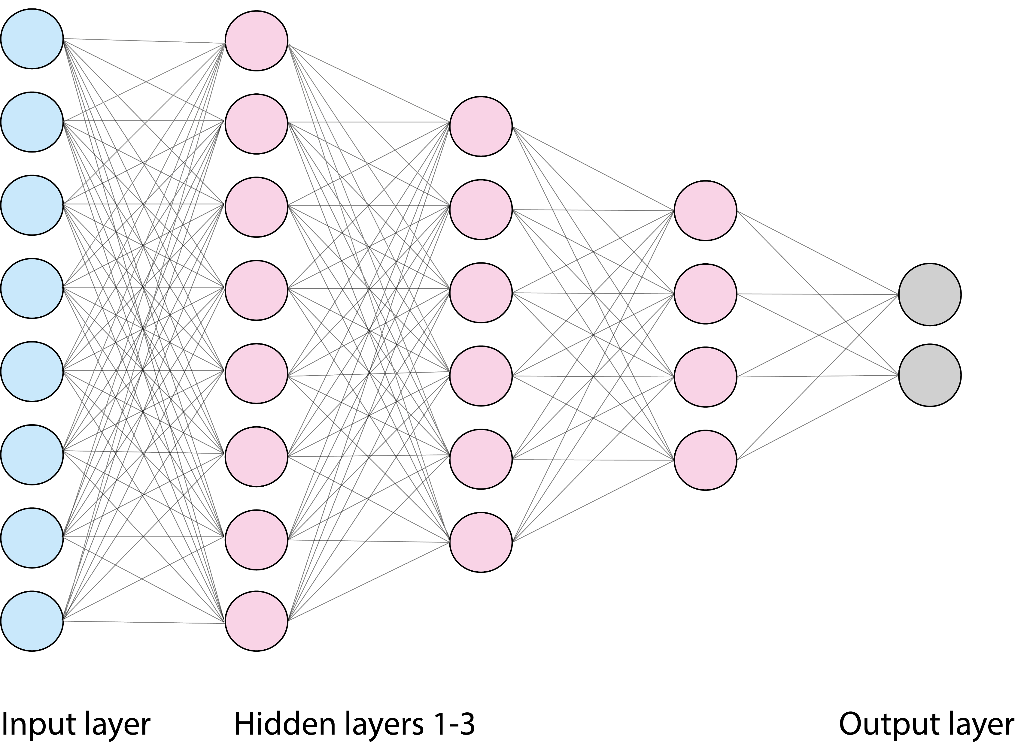
Deep Neural Networks
Common type of DL are Deep Neural Networks (DNNs)⁶
DNN > 2 hidden layers
Single layer networks have been experimented with in the past for SDM, performed terribly!^{7,8}
Possible advantages for SDM:
Can handle correlated input features
Can include species interactions
Easy to scale up
Let’s look deeper at what a neural network actually does and the application to SDM

Slide 7
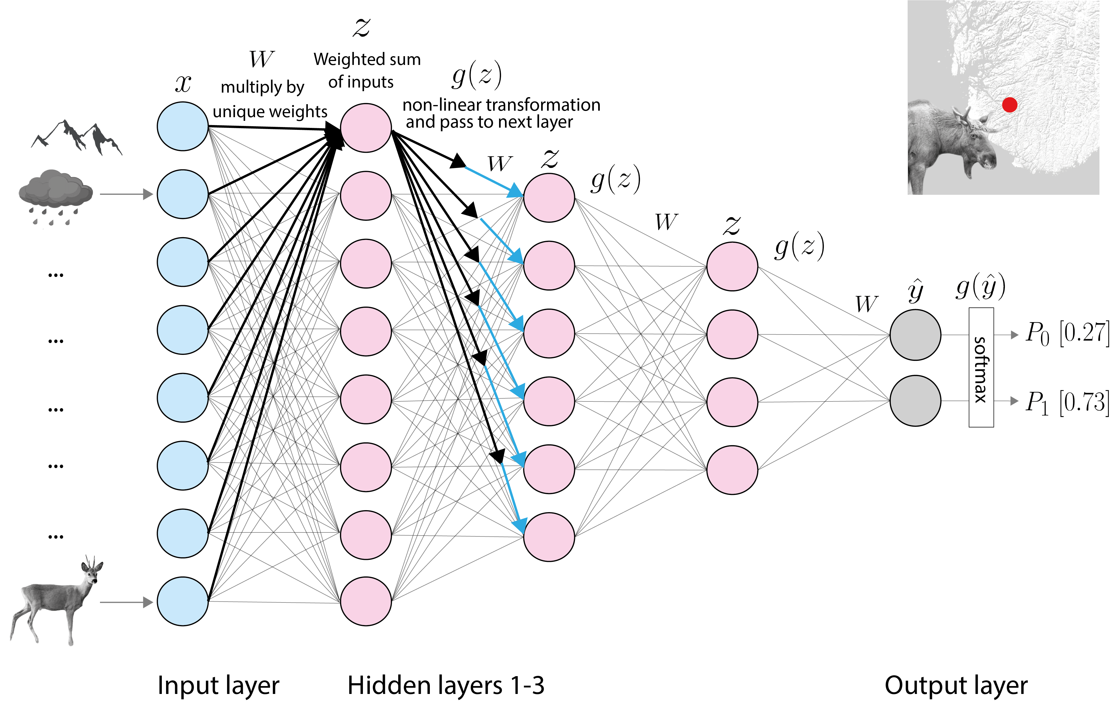
DNN
Applied to SDM

Slide 8
The research
Aim:
Proof of concept DL-SDM
Using pre-existing dataset of Worlds Ungulates
Goals to assess:
Types of input data
Evaluation methods
Model architecture
Performance compared to MaxEnt
Potential for large scale implementation
v
3.6

Slide 9
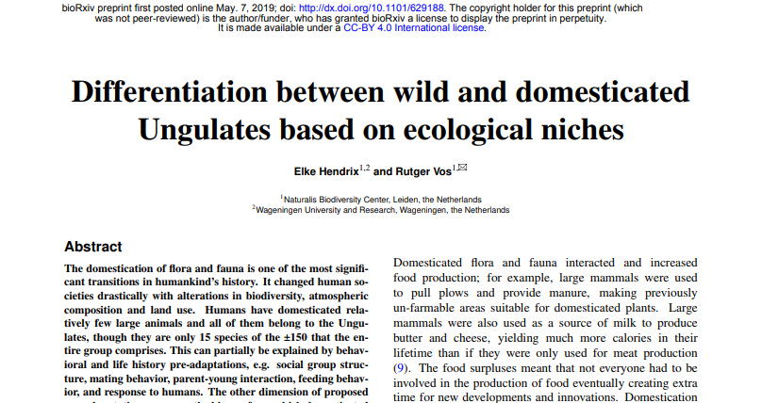
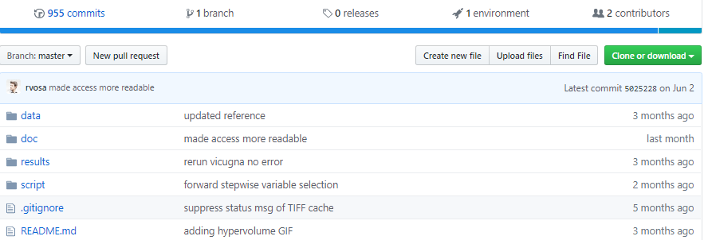
Stage 1.
Pilot model:
Same data and variables as Hendrix & Vos used to model distribution of 153 ungulate species with MaxEnt
Allows for direct comparison
Range of 10 – 882 observations per species
Negative examples (pseudo-absences sampled from within 1000km buffer)

Slide 10
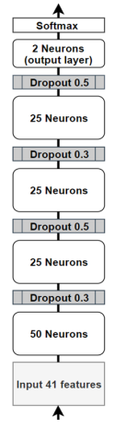
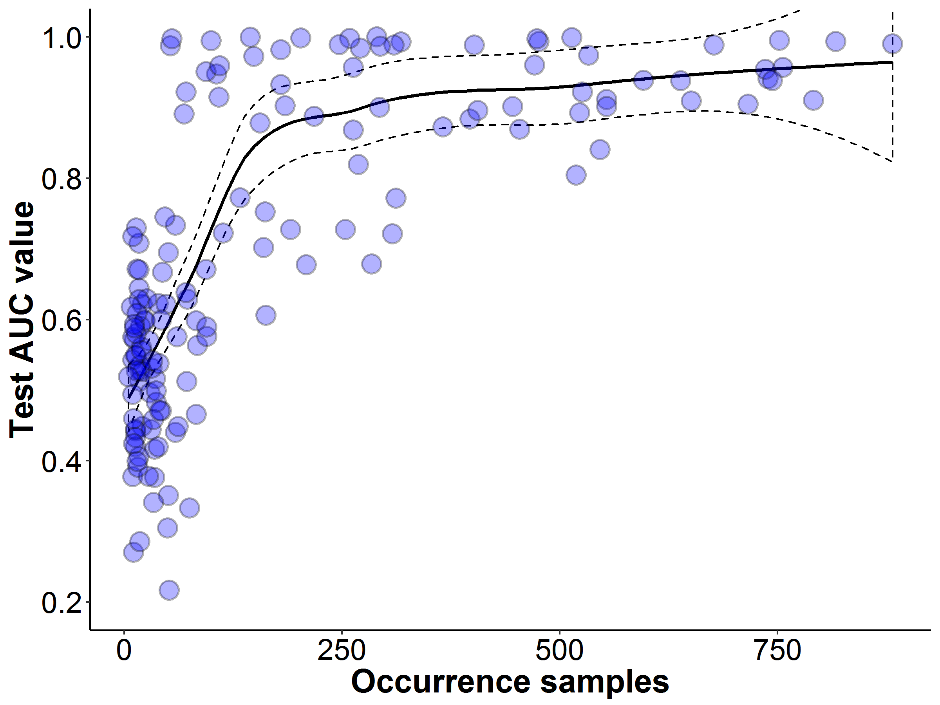
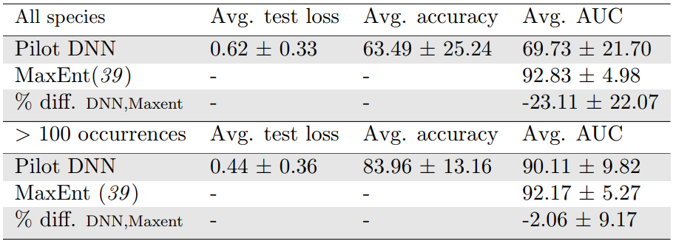
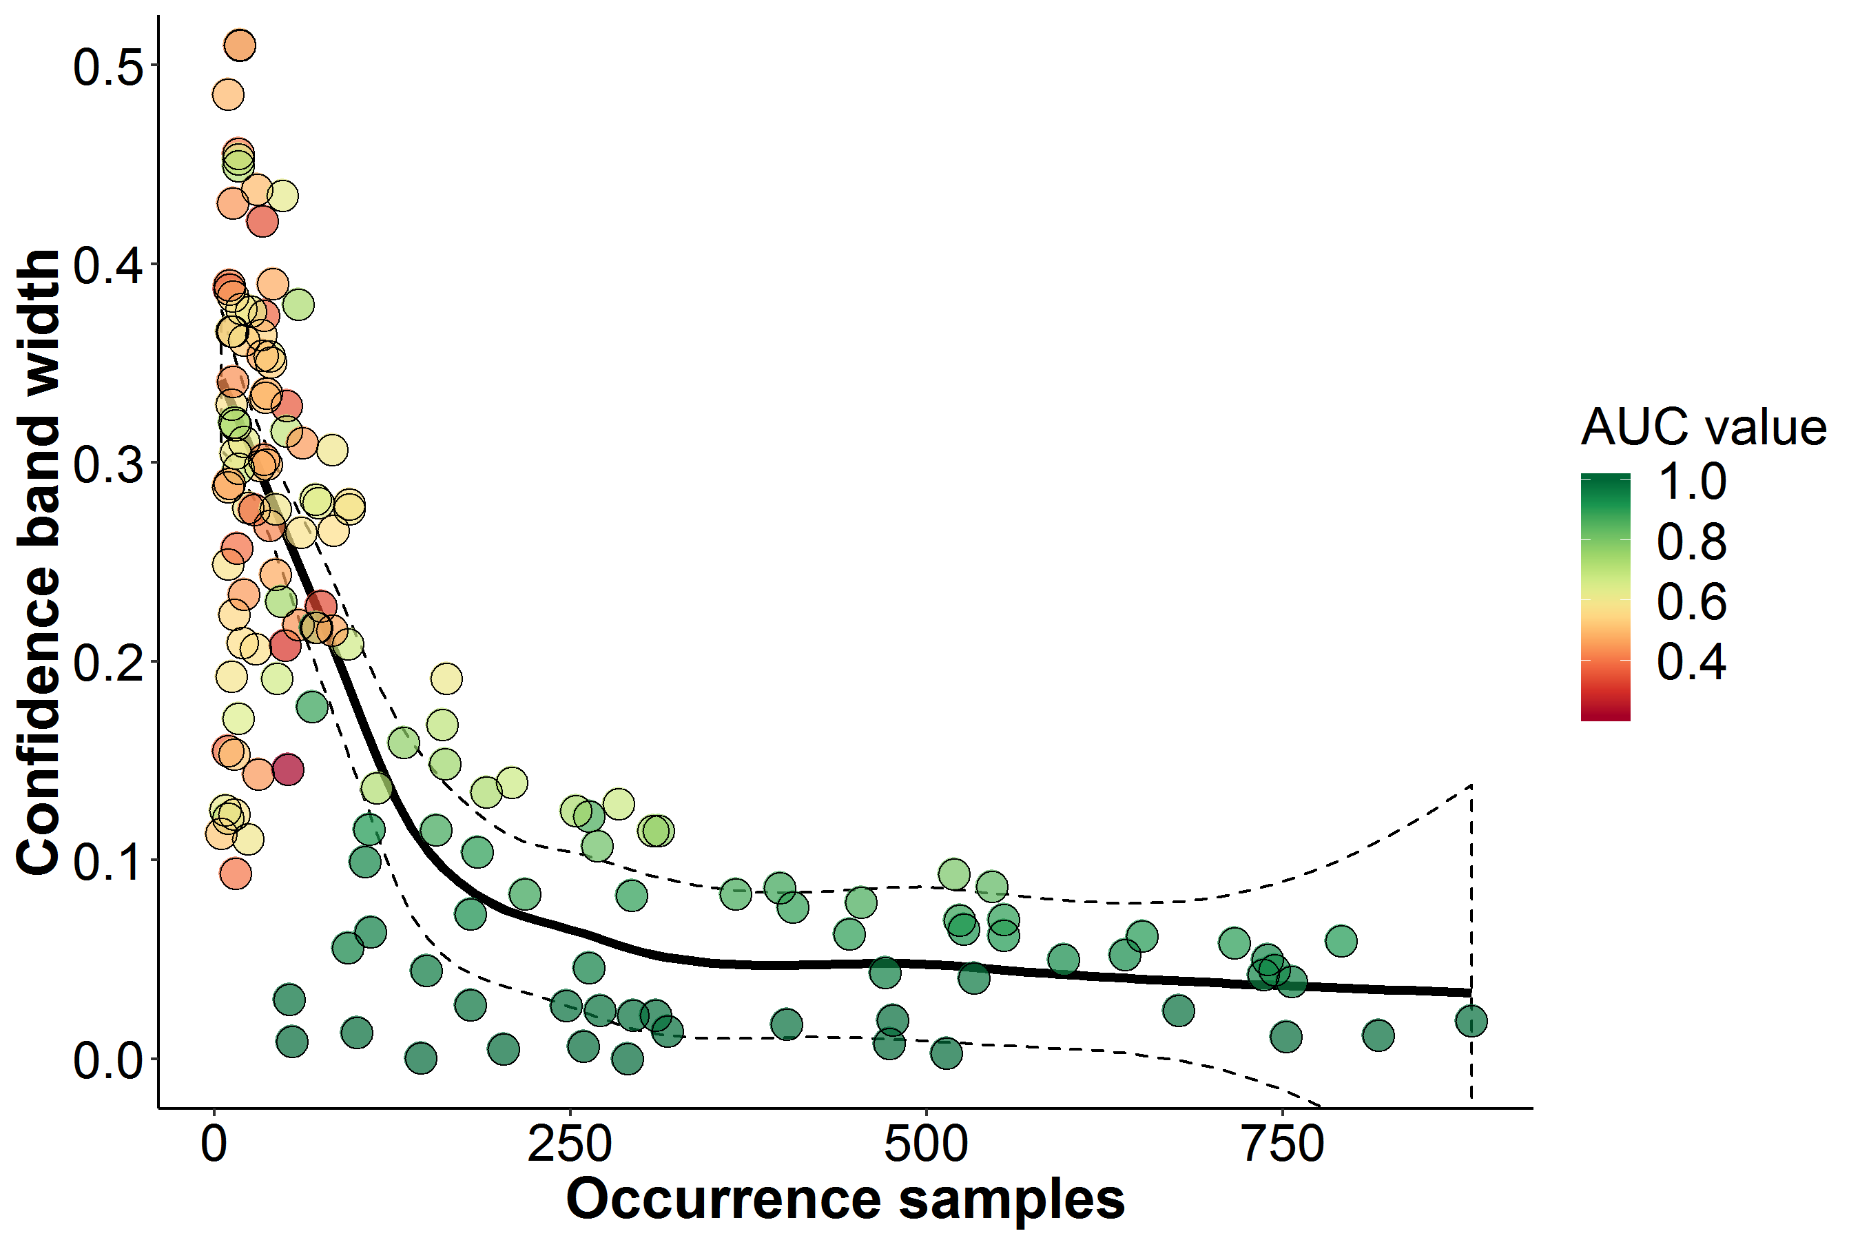
Stage 1.
Pilot model & performance Comparison to MaxEnt
Performs considerably worse if all species taken into account
Already pretty close if only species >100 occurrences taken into account
What does this mean in terms of predicted global distributions?

Slide 11
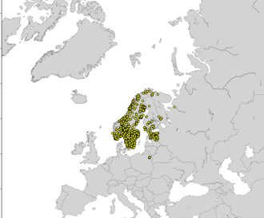
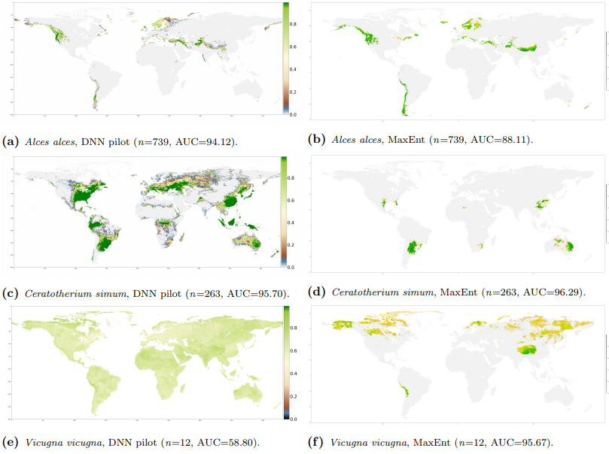
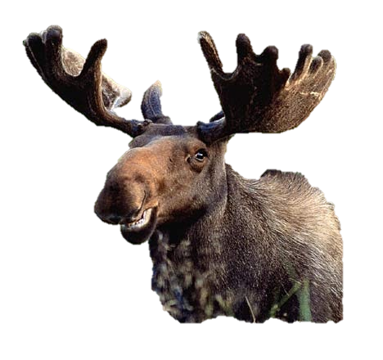
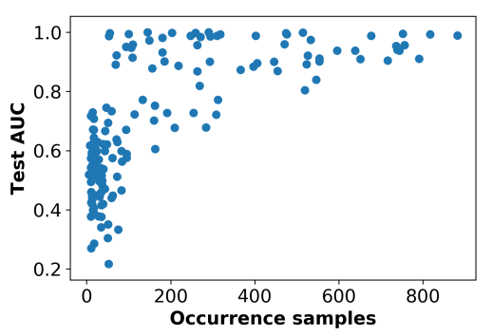
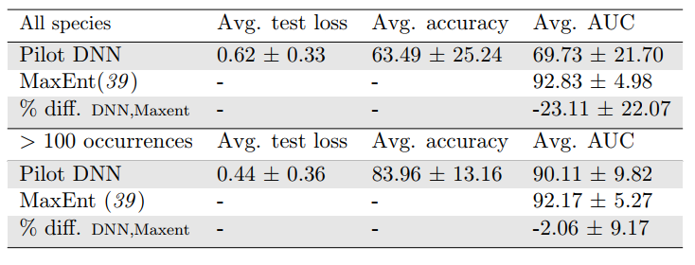
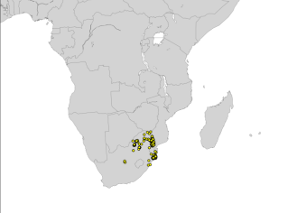
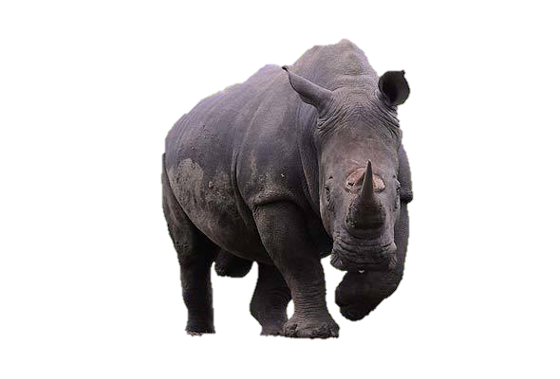
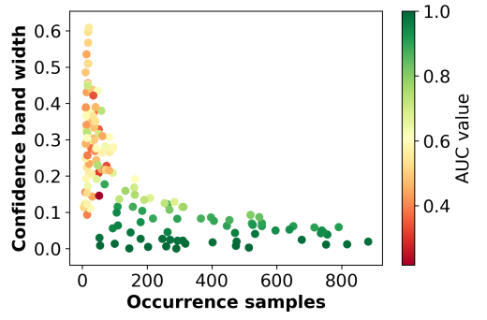
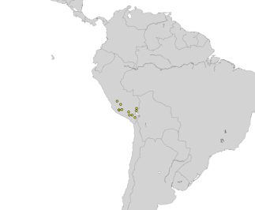
Stage 1.
Stage 1.
Pilot model & performance Comparison to MaxEnt
Pilot model & performance Comparison to MaxEnt
Performs considerably worse if all species taken into account
Already pretty close if only species >100 occurrences taken into account
What does this mean in terms of predicted global distributions?

Slide 12
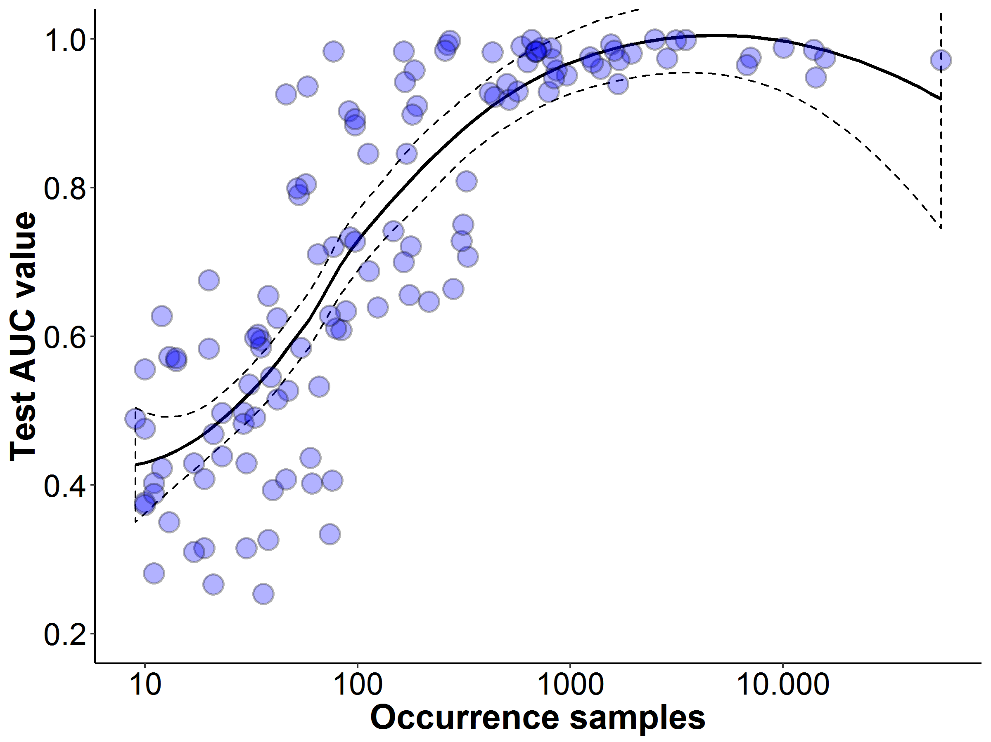
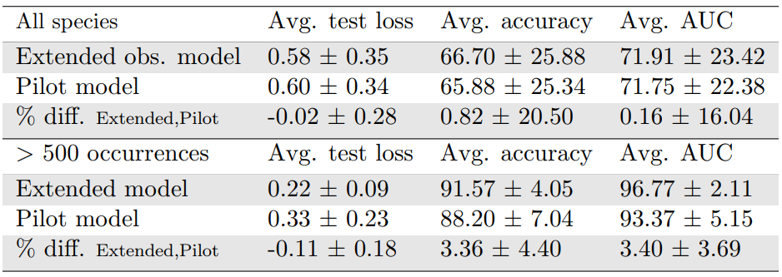
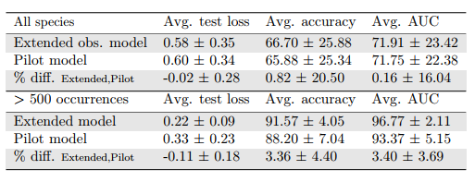
Stage 2.
Improving the model by extending the number of observations
Source additional observations from GBIF
120 species included, with range of 10 – 58.329 observations
Model architecture was kept the same
Only really improves on species with high number of occurrences

Slide 13
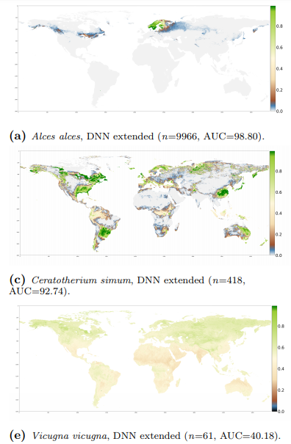
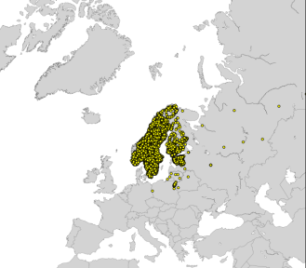
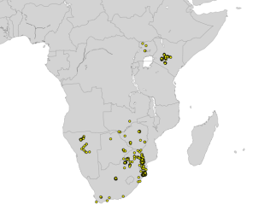
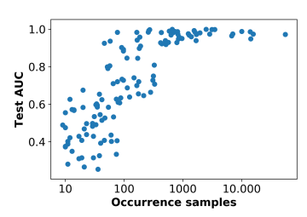
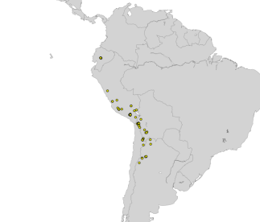
Stage 2.
Improving the model by extending the number of observations
Source additional observations from GBIF
120 species included, with range of 10 – 58.329 observations
Model architecture was kept the same
Only really improves on species with high number of occurrences

Slide 14
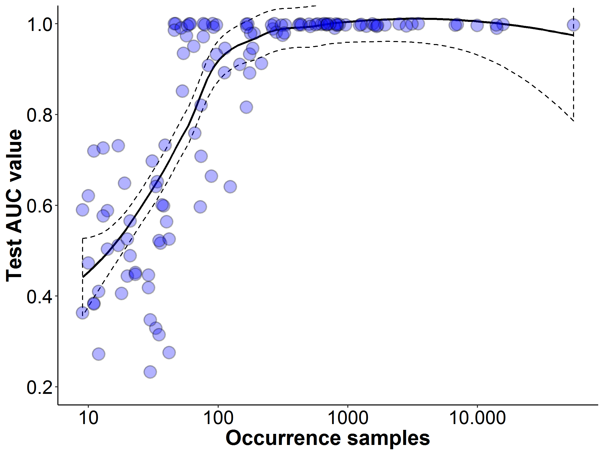
Stage 3.
Extended observations and variables:
Include additional 21 habitat variables as well as species co-occurrences
Change the selection of pseudo-absences, from within buffer to global
Improves performance considerably over all species!

Slide 15
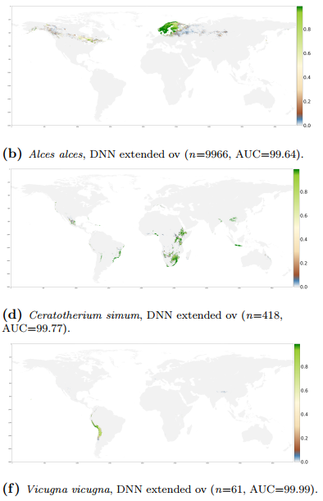
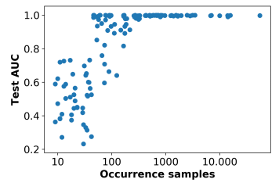
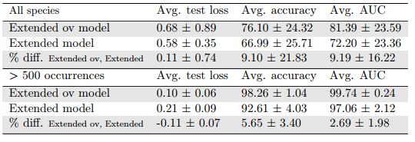
Stage 3.
Extended observations and variables:
Include additional 21 habitat variables as well as species co-occurrences
Change the selection of background locations, from within IUNC Range to entire globe

Slide 16
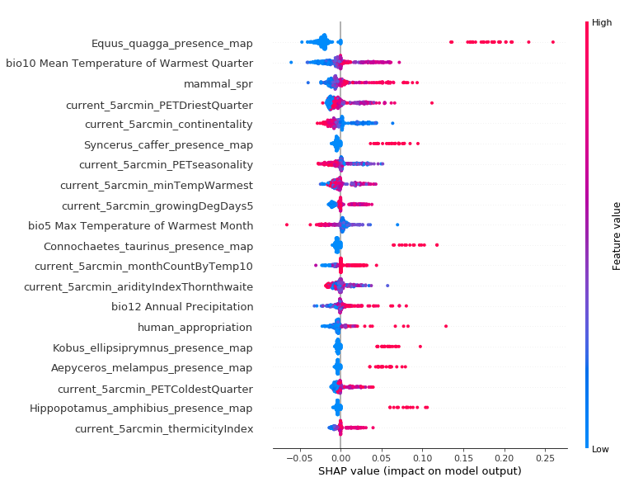
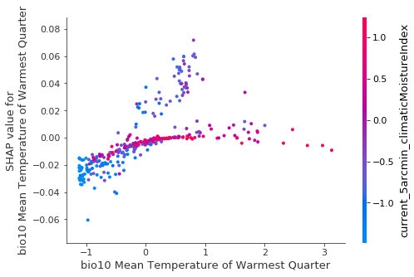
Possibility to dig in deeper
Feature importance and interaction effects
Determine variable importance for each individual grid cell

Slide 17
Relay to research goals
Assess types of input data
Requires both abiotic and biotic environmental variables
Assess model architecture
Relatively shallow with only 4 hidden layers
Evaluation methods
AUC values and prediction maps can be used to evaluate performance and compare with other methods
Performance compared to MaxEnt
Worse for low and similar for large sample size given only abiotic environmental variables
Extending observations, adding (biotic) variable and adjusting pseudo-absence sampling leads to large improvement
Potential for large scale implementation
Not assessed yet, challenge for the future

Slide 18
Future research
From separate model per species to single large multiclassification
Single model predicting probabilities of presence for all species
Likely needs to be much deeper
Does not need to learn weights from scratch
Can retrain weights to optimize for specific species of interest
Modelling shifting distributions (climate change)
Infuse time-dynamics with species interactions
Would require completely different type of DL-SDM, based on RNN
Comparison with mechanistic theoretical models
Does the DL model find patterns in observational data that validate theory?

Slide 19
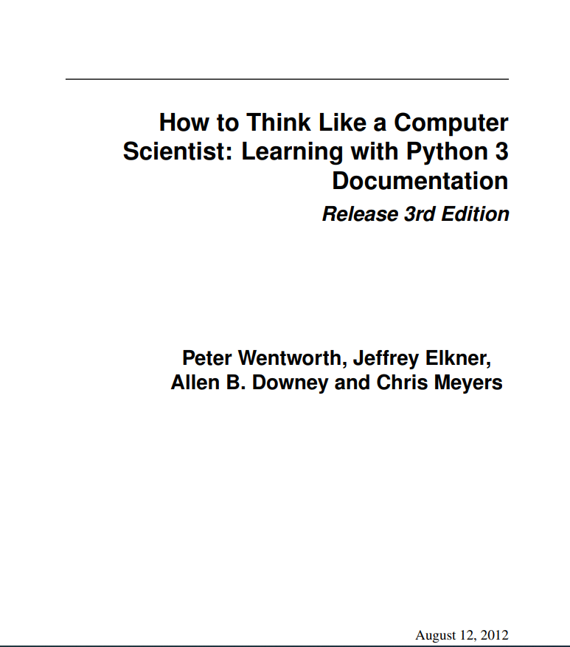
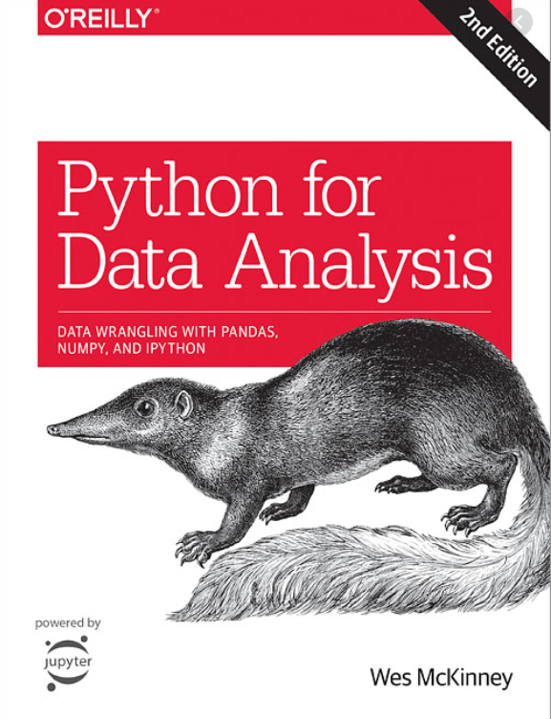
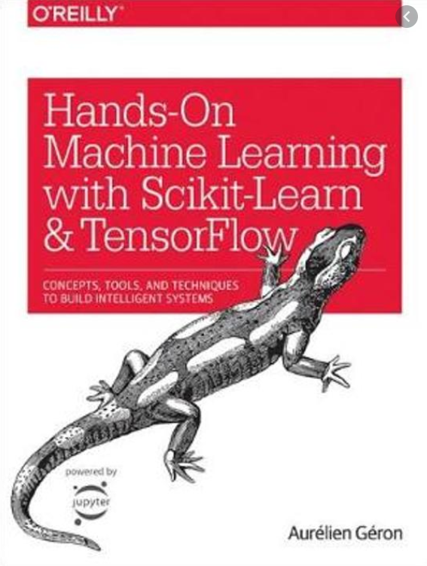
Getting started
Free courses
Handy instructional books
And website

Slide 20
Thank you for your attention!
Questions?

Slide 21
References
McGill, B. J., Etienne, R. S., Gray, J. S., Alonso, D., Anderson, M. J., Benecha, H. K., ... & Hurlbert, A. H. (2007). Species abundance distributions: moving beyond single prediction theories to integration within an ecological framework. Ecology letters, 10(10), 995-1015.
Troudet, J., et al. “Taxonomic bias in biodiversity data and societal preferences”. In: Scientific Reports, 7(1) (2017), 9132.
Collen, B., et al. “The tropical biodiversity data gap: addressing disparity in global monitoring”. In: Tropical Conservation Science, 1(2) (2008), 75-88.
Antoine Guisan and Niklaus E Zimmermann. “Predictive habitat distribution models in ecology”. In: Ecological modelling, 135.2-3 (2000), pp. 147–186
Cebon, Peter. 1998. Views from the Alps: regional perspectives on climate change. Cambridge, Mass: MIT Press.
Yoav Shoham et al. The AI Index 2018 Annual Report. 2018
Shinji Fukuda et al. “Habitat prediction and knowledge extraction for spawning European grayling (Thymallus thymallus L.) using a broad range of species distribution models”. In: Environmental modelling & software 47 (2013), pp. 1–6.
Xinhai Li and Yuan Wang. “Applying various algorithms for species distribution modelling”. In: Integrative Zoology 8.2 (2013), pp. 124–135.

Slide 22
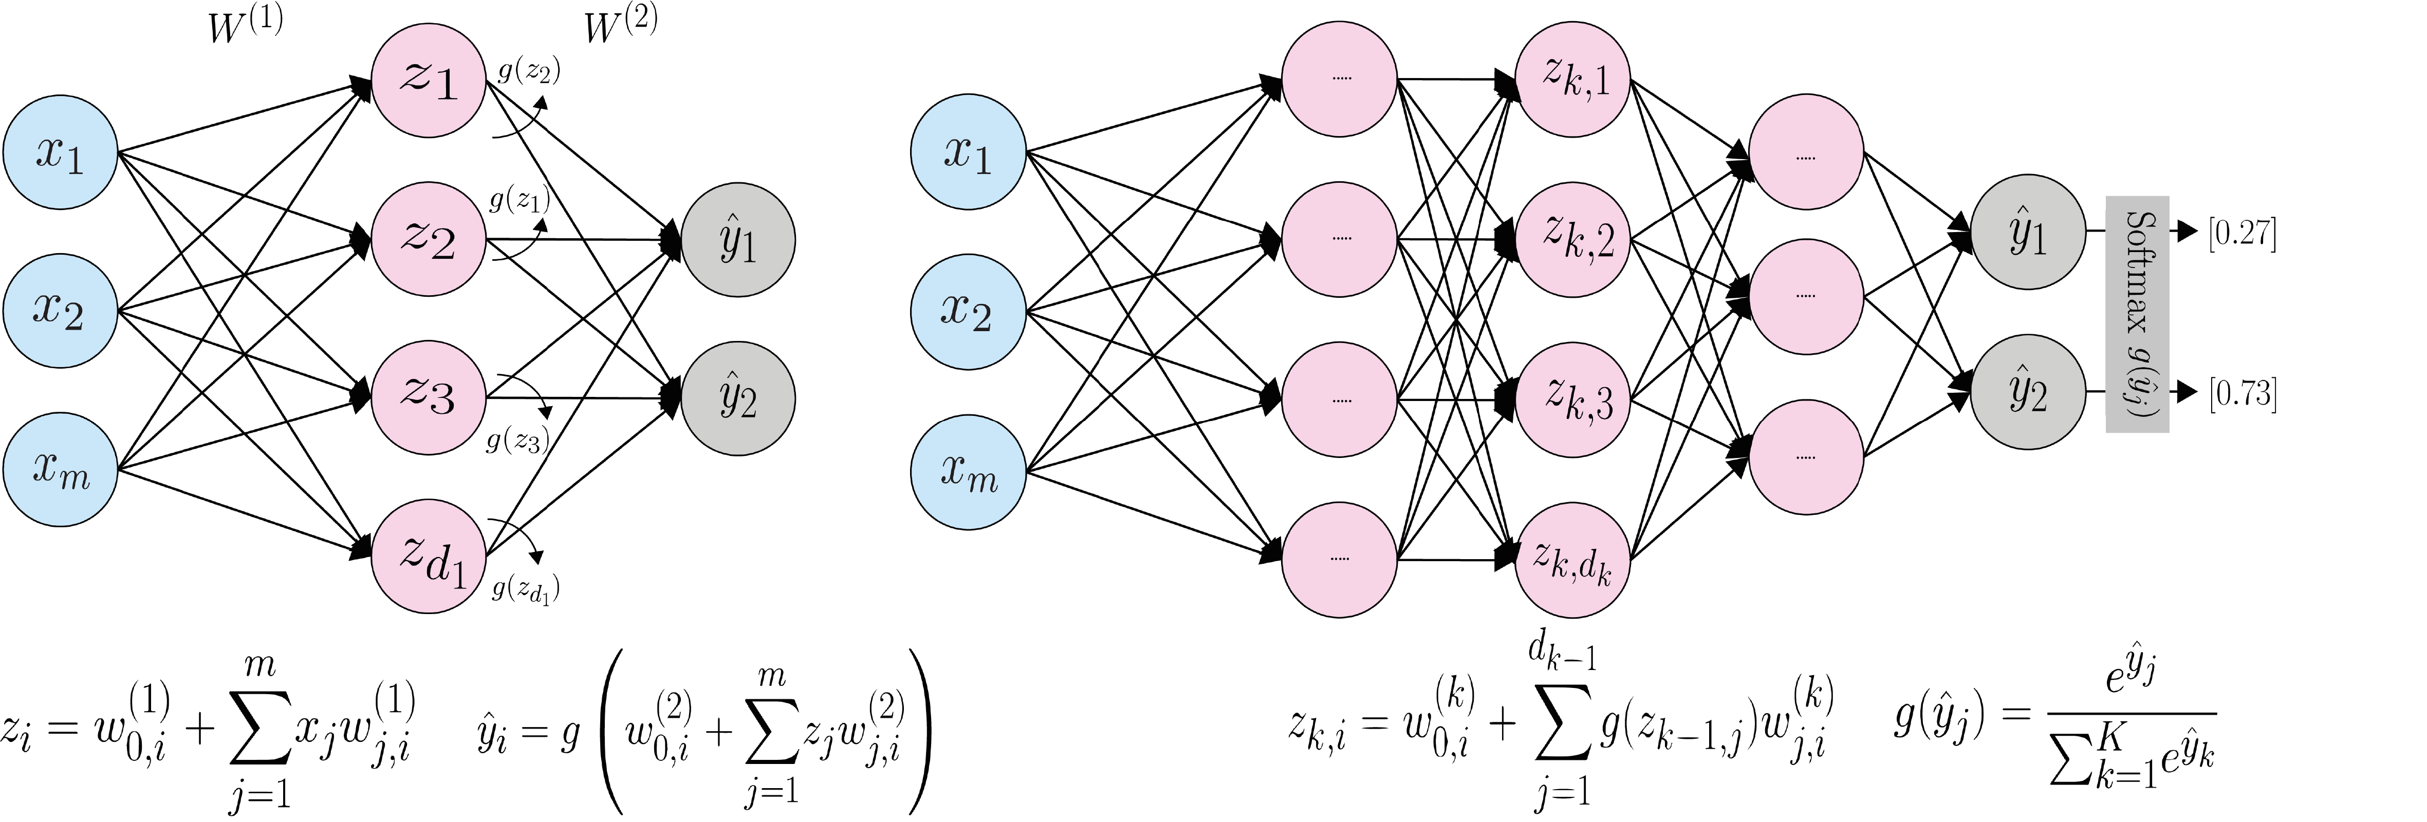
DNN
Formal single and multi-layered network (adapted from MIT, 2019)

